Slide 1
Customer Relationship Infographics
Here is where this template begins

Slide 2
Customer Relationship Infographics
Reduces Churn
01
Mercury is the closest planet to the Sun
Building Customer Relationships
Customer Lifetime Value
02
Jupiter is the biggest planet of them all
Mercury is the closest planet to the Sun and the smallest one in the entire Solar System
Brand Advocates
03
Venus has a beautiful name, but is very hot

Slide 3
Customer Relationship Infographics
70%
Mercury
Mercury is the closest planet to the Sun
30%
Jupiter
Jupiter is a gas giant named after a Roman god

Slide 4
Customer Relationship Infographics
01
02
Mars
Jupiter
Despite being red, Mars is a cold place
Jupiter is a gas giant and the biggest planet
03
04
Mercury
Venus
Mercury is the closest planet to the Sun
Venus has a beautiful name, but is hot

Slide 5
Customer Relationship Infographics
How to Build Strong Customer Relationships
Write Killer Emails | Mercury is the closest planet to the Sun
Embrace Pathological Empathy | Venus has a very beautiful name, but is hot
Blow Away Their Expectations | Mars is a cold place full of iron oxide dust
Seek Feedback and Show You Care | Jupiter is a gas giant named after a Roman god
Be Consistent in Your Interactions | Earth is the third planet from the Sun
Establish Trust | Saturn is a gas giant and has several rings
Reward Loyalty | Ceres is located in the main asteroid belt

Slide 6
Customer Relationship Infographics
1
Neptune
Neptune is the farthest planet from the Sun
2/10
2
Jupiter
Jupiter is the biggest planet of them all
1/10
3
Ceres
Ceres is located in the main asteroid belt
4/10
4
Pluto
Pluto is considered a dwarf planet
3/10

Slide 7
Customer Relationship Infographics
25 %
75 %
Venus
Mercury
Venus has a very beautiful name, but is terribly hot
It is the closest planet to the Sun and the smallest

Slide 8
Customer Relationship Infographics
02
03
Order
Sales
Despite being red, Mars is a cold place
Jupiter is a gas giant and the biggest planet
01
04
Marketing
Customer Relationship Management
Support
Mercury is the closest planet to the Sun
Venus has a beautiful name, but is hot

Slide 9
Customer Relationship Infographics
1
Satisfaction
Neptune is the farthest planet from the Sun
9/10
2
Service
Jupiter is the biggest planet of them all
8/10
3
Quality
Ceres is located in the main asteroid belt
7/10
4
Marketing
Pluto is considered a dwarf planet
3/10

Slide 10
Customer Relationship Infographics
01
02
Service
Quality
Mercury is the closest planet to the Sun
Neptune is the farthest planet from the Sun
03
04
Feedback
Conversation
Jupiter is a gas giant and the biggest planet
Despite being red, Mars is a cold place
05
06
Orders
Sales
Venus has a beautiful name, but is hot
Pluto is considered a dwarf planet

Slide 11
Customer Relationship Infographics
Customer Relationship Automation
01
02
CRM
Use Technology
Mercury is the closest planet to the Sun
Neptune is the farthest planet from the Sun
03
04
Chatbots
Social Media
Jupiter is a gas giant and the biggest planet
Despite being red, Mars is a cold place
05
06
Automate Replies
Automated Feedback
Venus has a beautiful name, but is hot
Pluto is considered a dwarf planet

Slide 12
Customer Relationship Infographics
In order to build good customer relationships you need to…
01 | Customize your approach with warm greetings depending upon the scenario
02 | Make your customers feel that you understand what they want
03 | Some customers are truly interested in the ways you build customer relationships
04 | Keep your customers notified about the things they are interested to do business with you

Slide 13
Customer Relationship Infographics
1
Satisfaction
Marketing
2
Pluto is now considered a dwarf planet
Neptune is the farthest planet from the Sun
9/10
6/10
3
Quality
Service
4
Ceres is located in the main asteroid belt
Jupiter is the biggest planet of them all
8/10
4/10

Slide 14
Customer Relationship Infographics
Integrate Customer Service Etiquette
Use positive words and phrases | Despite being red, Mars is a very cold place
Practice active listening | Jupiter is a gas giant and the biggest planet of them all
Offer Gratitude | It is the closest planet to the Sun and the smallest one
Show Empathy | Venus has a beautiful name, but is terribly hot

Slide 15
Customer Relationship Infographics
Multi Channel Communication approach
01
02
Understand audience
Choose Right Channels
Mercury is the closest planet to the Sun
Neptune is the farthest planet from the Sun
03
04
Brand Engagement
Tailored Approach
Jupiter is a gas giant and the biggest planet
Despite being red, Mars is a cold place

Slide 16
Customer Relationship Infographics
Appreciate Loyal Customers
01
02
03
Incentivize
Premium
Early Access
Mercury is the closest planet to the Sun
Despite being red, Mars is a cold place
Jupiter is a gas giant and the biggest planet

Slide 17
Customer Relationship Infographics
01
02
Mars
Jupiter
Despite being red, Mars is a cold place
Jupiter is a gas giant and the biggest planet
25 %
75 %

Slide 18
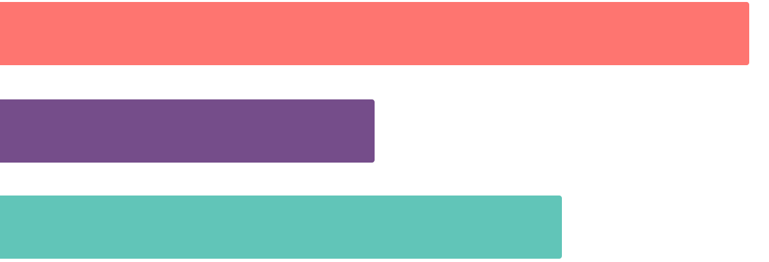
Customer Relationship Infographics
Mars
Mercury
Jupiter
Despite being red, Mars is a cold place
It is the closest planet to the Sun
It is a gas giant and the biggest planet
75 %
50 %
100 %
Follow the link in the graph to modify its data and then paste the new one here. For more info, click here

Slide 19
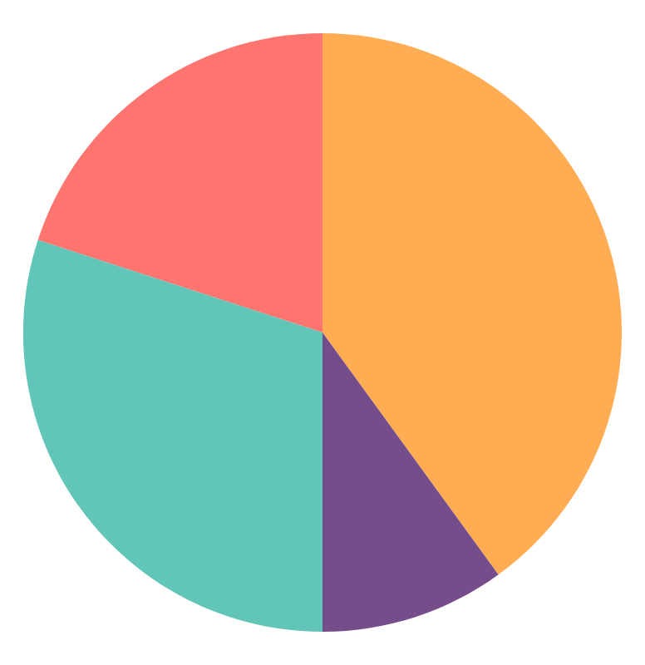
Customer Relationship Infographics
Satisfaction
20 %
It is the farthest planet from the Sun
Service
40 %
Jupiter is the biggest planet of them all
Quality
10 %
It is located in the main asteroid belt
Marketing
30 %
Pluto is considered a dwarf planet
Follow the link in the graph to modify its data and then paste the new one here. For more info, click here

Slide 20
Customer Relationship Infographics
01
02
03
04
Mercury
Jupiter
Venus
Neptune
Mercury is the closest planet to the Sun
Jupiter is a gas giant and the biggest planet
Venus has a beautiful name, but is hot
Neptune is the farthest planet from the Sun

Slide 21
Customer Relationship Infographics
50 %
75 %
Mars
Jupiter
Despite being red, Mars is a cold place
Jupiter is a gas giant and the biggest planet
50 %
75 %
Mercury
Venus
Mercury is the closest planet to the Sun
Venus has a beautiful name, but is hot

Slide 22
Customer Relationship Infographics
01
02
Order
Sales
Despite being red, Mars is a cold place
Jupiter is a gas giant and the biggest planet
03
04
Marketing
Support
Mercury is the closest planet to the Sun
Venus has a beautiful name, but is hot

Slide 23
Customer Relationship Infographics
5
Tips for Using Content to Build Better Customer Relationships
Create High-Quality Personalized Content | Mercury is the closest planet to the Sun
Instead of Selling Products, Tell Stories | Venus has a very beautiful name, but is hot
Enable Two-way Communication | Mars is a cold place full of iron oxide dust
Be Transparent, Authentic, and Reliable | Jupiter is a gas giant named after a Roman god
Focus on Both the Long and Short Game | Earth is the third planet from the Sun

Slide 24
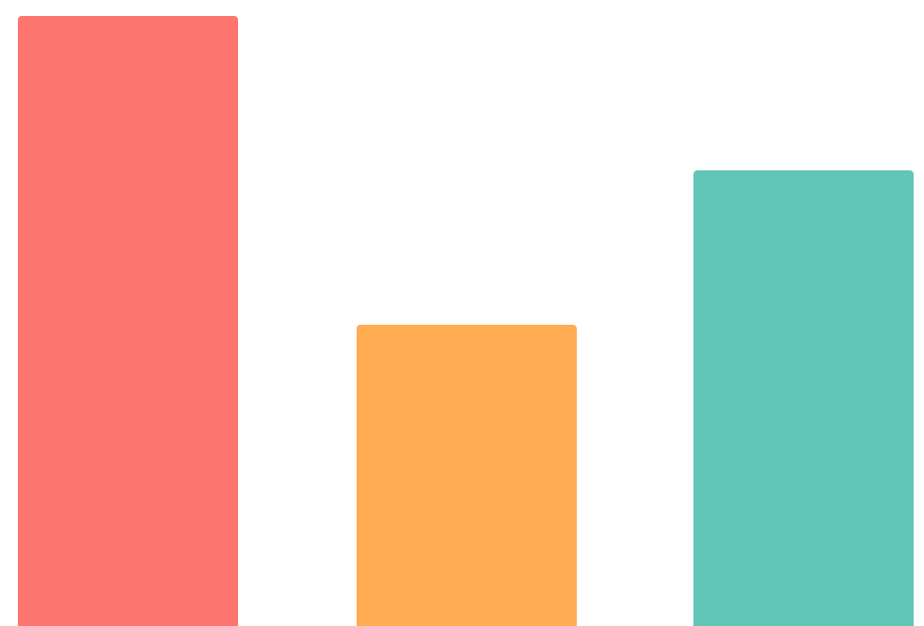
Customer Relationship Infographics
100 %
Satisfaction
It is the farthest planet from the Sun
50 %
Service
Jupiter is the biggest planet of them all
75 %
Quality
It is located in the main asteroid belt
Follow the link in the graph to modify its data and then paste the new one here. For more info, click here

Slide 25
Customer Relationship Infographics
35 %
Personalize customer relationships
Match your tone with your customer personality
Mercury is the closest planet to the Sun
40 %
Use advanced customer engagement tools
Venus has a beautiful name, but is very hot
25 %
Know your customer preferences
Jupiter is the biggest planet of them all

Slide 26
Customer Relationship Infographics
02
03
Mars
Jupiter
Despite being red, Mars is a cold place
Jupiter is a gas giant and the biggest planet
01
04
Mercury
Venus
Mercury is the closest planet to the Sun
Venus has a beautiful name, but is hot

Slide 27
Customer Relationship Infographics
Create Value for Customers
01
02
Understanding Your Customer Needs
Understand Your Value Proposition
Mercury is the closest planet to the Sun
Jupiter is a gas giant and the biggest planet
03
04
05
Educate Customers
Invest in Your Valuable Customers
Build Communities
Despite being red, Mars is a cold place
Venus has a beautiful name, but is hot
Earth is the planet where we all live on

Slide 28
Customer Relationship Infographics
01
Collect Feedback from Customers
02
Mercury
Neptune
Mercury is the closest planet to the Sun
Neptune is the farthest planet from the Sun
4/5
03
04
Jupiter
Mars
Jupiter is a gas giant and the biggest planet
Despite being red, Mars is a cold place

Slide 29
Customer Relationship Infographics
Jupiter
It is a gas giant and the biggest planet
60 %
Neptune
It is the farthest planet from the Sun
40 %

Slide 30
Customer Relationship Infographics
01
02
03
04
Mars
Despite being red, Mars is a cold planet
Mercury
Jupiter
Venus
Neptune
Mercury is the closest planet to the Sun
Jupiter is a gas giant and the biggest planet
Venus has a beautiful name, but is hot
Neptune is the farthest planet from the Sun

Slide 31
Customer Relationship Infographics
25 %
75 %
Venus
Mercury
Venus has a very beautiful name, but is terribly hot
It is the closest planet to the Sun and the smallest

Slide 32
Customer Relationship Infographics
04
03
02
01
Mars
Jupiter
Mars is a cold place full of iron oxide dust, which gives the planet its reddish cast
Venus
Jupiter is a huge gas giant named after the Roman god of the skies and the lightning
Mercury
Venus has a very beautiful name, but is actually terribly hot, hotter than Mercury
Mercury is the closest planet to the Sun and the smallest one in the entire Solar System

Slide 33
Instructions for use (premium users)
As a Premium user, you can use this template without attributing Slidesgo.
You are allowed to:
Modify this template.
Use it for both personal and commercial purposes.
Hide or delete the “Thanks” slide and the mention to Slidesgo in the credits.
Share this template in an editable format with people who are not part of your team.
You are not allowed to:
Sublicense, sell or rent this Slidesgo Template (or a modified version of this Slidesgo Template).
Distribute this Slidesgo Template (or a modified version of this Slidesgo Template) or include it in a database or in any other product or service that offers downloadable images, icons or presentations that may be subject to distribution or resale.
Use any of the elements that are part of this Slidesgo Template in an isolated and separated way from this Template.
Register any of the elements that are part of this template as a trademark or logo, or register it as a work in an intellectual property registry or similar.
For more information about editing slides, please read our FAQs or visit Slidesgo School:
https://slidesgo.com/faqs and https://slidesgo.com/slidesgo-school

Slide 34
Infographics
You can add and edit some infographics to your presentation to present your data in a visual way.
Choose your favourite infographic and insert it in your presentation using Ctrl C + Ctrl V or Cmd C + Cmd V in Mac.
Select one of the parts and ungroup it by right-clicking and choosing “Ungroup”.
Change the color by clicking on the paint bucket.
Then resize the element by clicking and dragging one of the square-shaped points of its bounding box (the cursor should look like a double-headed arrow). Remember to hold Shift while dragging to keep the proportions.
Group the elements again by selecting them, right-clicking and choosing “Group”.
Repeat the steps above with the other parts and when you’re done editing, copy the end result and paste it into your presentation.
Remember to choose the “Keep source formatting” option so that it keeps the design. For more info, please visit Slidesgo School.

